Slide 1
Peripheral Devices
Input-Output Interface
Asynchronous Data Transfer
Modes of Transfer
Priority Interrupt
Direct Memory Access
Input-Output Processor

Slide 2
Priority Interrupts
Priority
- Determines which interrupt is to be served first when two or more requests
are made simultaneously
- Also determines which interrupts are permitted to interrupt the computer while
another is being serviced
- Higher priority interrupts can make requests while servicing a lower priority
interrupt
A priority interrupt is a system that establishes priority over the various sources to determine
- which condition is to serviced first when two or more requests
arrive simultaneously
-which conditions are permitted to interrupt the computer while
another request is being serviced

Slide 3
Priority Interrupts
Priority Interrupt by Software (Polling)
Polling procedure is used to identify highest priority source by software
means
- common branch address for all the interrupts
- Priority is established by the order of polling the devices(interrupt sources)
- highest priority device is tested first and if interrupt is on , control
branches to service routine for this source otherwise next lower priority
source is tested
- Flexible since it is established by software
- Low cost since it needs a very little hardware
- Very slow
- if there are many interrupt time required to poll may exceed time available to
service IO device

Slide 4
Priority Interrupts
Priority Interrupt by Hardware
- Require a priority interrupt manager which accepts all the interrupt requests
to determine the highest priority request
- Fast since identification of the highest priority interrupt request is identified by
the hardware
- Fast since each interrupt source has its own interrupt vector to access
directly to its own service routine
- Can be addressed using serial or parallel connection of interrupt lines.
Example of serial is Daisy chaining Priority

Slide 5
Hardware Priority Interrupts – Daisy Chain
VAD 1
VAD 2
VAD 3
* Serial hardware priority function
* Interrupt Request Line
- Single common line
* Interrupt Acknowledge Line
- Daisy-Chain
Device 1
Device 2
Device 3
PI
PO
PI
PO
PI
PO
To next
device
Interrupt request
INT
CPU
Interrupt acknowledge
INTACK
Serial connection of all device that request an interrupt
Device with highest priority placed in first position followed by devices with lower
priority and so on.
Interrupt generated by any device → signals low state interrupt line
CPU responds by enabling interrupt acknowledgement (INTACK) line.
device receives PI=1 and passes to next only when not requesting else PI=0
Thus device with PI=1 and PO=0 is one with highest priority requesting interrupt

Slide 6
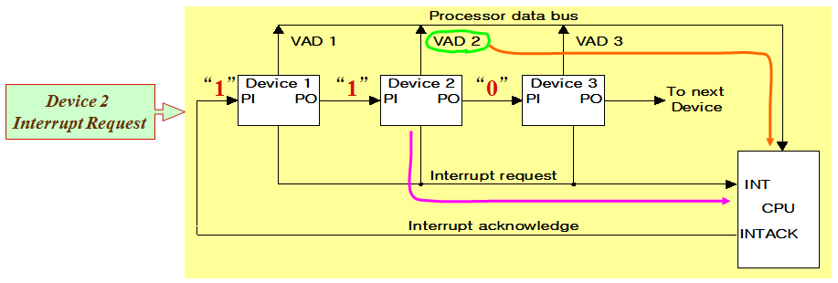
Hardware Priority Interrupts – Daisy Chain
Example: Daisy chain working

Slide 7
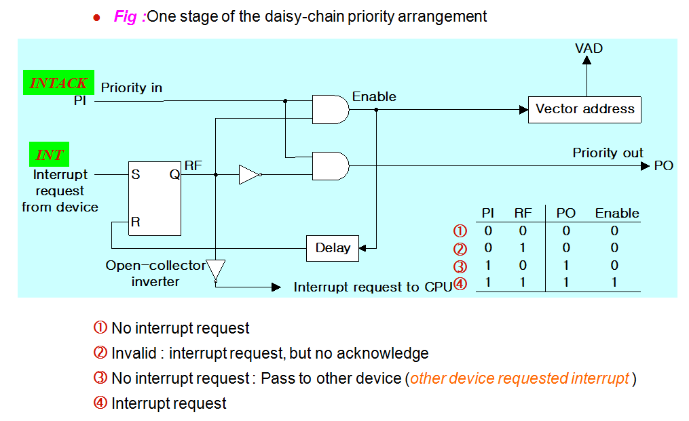
Hardware Priority Interrupts – Daisy Chain

Slide 8
Parallel Priority Interrupts
Interrupt register
Bus
Buffer
Disk
0
I
0
y
Printer
1
I
x
1
Priority
0
Reader
2
I
encoder
2
0
VAD
Keyboard
3
I
0
to CPU
3
0
0
IEN
IST
0
Mask
0
register
1
Enable
2
Interrupt
3
to CPU
INTACK
from CPU
IEN: Set or Clear by instructions ION or IOF
IST: Represents an unmasked interrupt has occurred. INTACK enables tristate Bus Buffer to load VAD generated by the Priority Logic
Interrupt Register:
- Each bit is associated with an Interrupt Request from different Interrupt Source - different priority level
- Each bit can be cleared by a program instruction
Mask Register:
- Mask Register is associated with Interrupt Register
- Each bit can be set or cleared by an Instruction

Slide 9
Priority Encoder
Determines the highest priority interrupt when more than one interrupts take place
Priority Encoder Truth table
Inputs
Outputs
I₀
I₁
I₂
I₃
x y IST
Boolean functions
1 d d d
0 0 1
0 1 d d
0 1 1
0 0 1 d
1 0 1
x = I₀' I₁'
0 0 0 1
1 1 1
y = I₀' I₁ + I₀’ I₂’
0 0 0 0
d d 0
(IST) = I₀ + I₁ + I₂ + I₃

Slide 10
Interrupt Cycle
At the end of each Instruction cycle
- CPU checks IEN and IST
- If IEN • IST = 1, CPU -> Interrupt Cycle
  SP ← SP - 1 Decrement stack pointer
  M[SP] ←  PC Push PC into stack
  INTACK ←  1 Enable interrupt acknowledge
  PC ←  VAD Transfer vector address to PC
  IEN ←  0 Disable further interrupts
  Go To Fetch to execute the first instruction
  in the interrupt service routine

Slide 11
Initial and Final Operations
0
JMP DISK
DISK
7
Program to service
1
JMP PTR
magnetic disk
VAD=00000011
3
2
JMP RDR
PTR
Program to service
3
JMP KBD
8
line printer
KBD
interrupt
1
Main program
RDR
749
current instr.
Program to service
750
character reader
KBD
4
Stack
Program to service
11
5
keyboard
2
256
Disk
interrupt
255
256
750
Initial and Final Operations
6
9
10
Each interrupt service routine must have an initial and final set of
operations for controlling the registers in the hardware interrupt system
Initial Sequence
[1] Clear lower level Mask reg. bits
[2] IST <- 0
[3] Save contents of CPU registers
[4] IEN <- 1
[5] Go to Interrupt Service Routine
Final Sequence
[1] IEN <- 0
[2] Restore CPU registers
[3] Clear the bit in the Interrupt Reg
[4] Set lower level Mask reg. bits
[5] Restore return address, IEN <- 1

Slide 12
Input/Output Organization <number>
Overview
Peripheral Devices
Input-Output Interface
Asynchronous Data Transfer
Modes of Transfer
Priority Interrupt
Direct Memory Access
Input-Output Processor

Slide 14
Input/Output Organization <number>
Direct Memory Access
* Block of data transfer between high speed devices like Disk and Memory
* DMA controller - Interface which takes over the buses to manage the transfer directly between
Memory and I/O Device, freeing CPU for other tasks
* CPU initializes DMA Controller by sending memory address and the block size (number of words)
Fig 1: CPU bus signals for DMA transfer
ABUS
Address bus
Bus request
BR
DBUS
Data bus
Bus granted
BG
CPU
RD
Read
WR
Write
Fig 2: Block diagram of DMA controller
Data bus
Data bus
Address bus
Address register:
Contains an address to specify
Desired location in memory
Word count register
Holds no. of words to be transferred
Control register
Specifies the mode of transfer
buffers
buffers
DMA select
DS
Address register
RS
Internal Bus
Read
RD
Word count register
Write
WR
Control
logic
Control register
Bus request
BR
Bus grant
BG
Interrupt
Interrupt
DMA request
DMA acknowledge
to I/O device

Slide 15
Input/Output Organization <number>
Direct Memory Access
RD and WR is bidirectional
When BG=0 CPU can communicate with DMA Register
When BG=1 CPU left the buses and DMA can communicate directly with memory
DMA Transfer can be made in several ways
Burst Transfer : a block sequence consisting of memory words is transferred
in continuous burst while the DMA controller is master of memory
bus
- This mode of transfer is needed for fast devices such as magnetic
disk where data transmission cannot be stopped or slowed down
until an entire block is transferred
(2) Cycle stealing : Alternative technique called cycle stealing allows DMA controller to
transfer one data word at time after which it must return control of
the buses to the CPU.
- CPU merely delays its operation for one memory cycle to allow the
direct memory I/O transfer to “steal” one memory cycle

Slide 16
Input/Output Organization <number>
DMA I/O Operation
DMA is first initialized by CPU. After that DMA starts and continues to transfer data between memory and peripheral unit until an entire block is transferred.
CPU initializes the DMA by sending following information through data bus:
    (1) Starting address of the memory block (for read/write)
    (2) Word Count (no. of words in memory block)
    (3) Control to specify mode of transfer (E.g. read/write)
    (4) A control to start DMA Transfer

Slide 17
Input/Output Organization <number>
Cycle Stealing
While DMA I/O takes place, CPU is also executing instructions
DMA Controller and CPU both access Memory -> Memory Access Conflict
Memory Bus Controller
- Coordinating the activities of all devices requesting memory access
- Priority System
Memory accesses by CPU and DMA Controller are interwoven,
with the top priority given to DMA Controller
Cycle Steal
- CPU is usually much faster than I/O(DMA), thus
CPU uses the most of the memory cycles
- DMA Controller steals the memory cycles from CPU
- For those stolen cycles, CPU remains idle
- For those slow CPU, DMA Controller may steal most of the memory
cycles which may cause CPU remain idle long time

Slide 18
Input/Output Organization <number>
DMA Transfer
Interrupt
BG
Random-access
CPU
memory unit (RAM)
BR
RD
WR
Addr
Data
RD
WR
Addr
Data
Read control
Write control
Data bus
Address bus
Address
select
RD
WR
Addr
Data
DS
DMA ack.
RS
DMA
I/O
BR
Controller
Peripheral
device
BG
DMA request
Interrupt

Slide 19
Input/Output Organization <number>
I/O Processor - Channel
Channel
- Processor with direct memory access capability that communicates with I/O devices
- Channel accesses memory by cycle stealing
- Unlike DMA Controller, IOP can fetch and execute its own instruction
- IOP Instructions (Commands) specially designed to facilitate I/O transfer.
- Data gathered in IOP at device rate and bit capacity while CPU executing own program
- Transfer between IOP and Device similar to Programmed I/O and
transfer between IOP and Memory similar to DMA
- CPU is master while IOP is slave processor
- CPU initiates the channel by executing a channel I/O class instruction and once initiated, channel operates independent of the CPU
Central
processing
unit (CPU)
Peripheral devices
Memory
Memory Bus
unit
PD
PD
PD
PD
Input-output
processor
I/O bus
(IOP)

Slide 20
Input/Output Organization <number>
Channel CPU Communication
CPU operations
IOP operations
Send instruction
to test IOP.path
Transfer status word
to memory
If status OK, then send
start I/O instruction
to IOP.
Access memory
for IOP program
CPU continues with
another program
Conduct I/O transfers
using DMA;
Prepare status report.
I/O transfer completed;
Interrupt CPU
Request IOP status
Transfer status word
Check status word
to memory location
for correct transfer.
Continue

